Slide 1
AI Code Reviewer App
Done by :
Shaik Shaheer
Innomatics research labs

Slide 2
Problem Statement
Current Landscape: Growing demand for high-quality software.
Manual Code Review Challenges:
Time-Consuming
Human Error
Resource Intensive
Scalability Issues
Need:
Efficiency
Accuracy
Cost-Effectiveness
Scalability

Slide 3
Proposed Solution: AI Code Reviewer App
AI-Powered Automation
Consistent Standards
Comprehensive Analysis
Continuous Learning
Why Now?
Technological Advancements
Market Demand
Competitive Edge

Slide 4
Steps to create the app
Required Libraries
openai
Streamlit
Steps for OpenAI
Install
Import
Read the API key
Init the client
Send prompt to LLM
Print the response

Slide 5
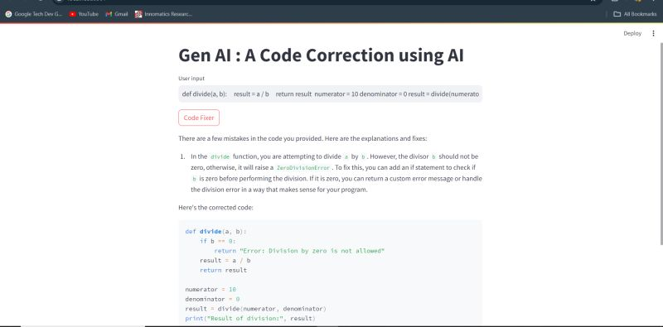
Output
The user should upload their code and press the ‘Code Fixer’ button.
Then, the app will generate the corrected code
Additionally, the app will display the mistakes and provide a proper explanation.

